Slide 1
Self Organizing Maps Part I

Slide 2
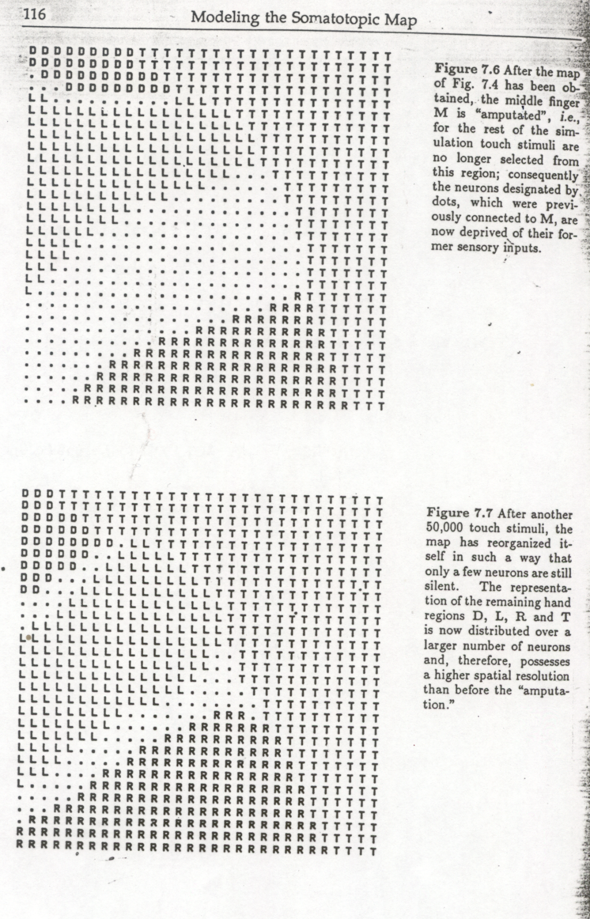

Slide 3
Visualizing Weights and Vectors in Same Space

Slide 4
Hamming Net 1. Pick number of cluster units. 2. Assign weights to cluster unit input weights 3. Give data point; value of cluster indicates number agree – number disagree. Largest value should be chosen cluster
MAXNET

Slide 5
What if you only know the number of clusters but not where they are in input space? (e.g. in non-uniform distribution)
Kohonen Net; finds by itself via self–organization the location of cluster points.

Slide 6
Self-Organizing Network
Weights from input to neurons
Topology between neurons

Slide 7
Self-Organizing Network
Weights from input give “location” to neuron
Kohonen algorithm results in “winner” neuron
After training, close input patterns have topologically close winners
Results in Equi-probable Continuous Mapping (without teacher)

Slide 9
Go to Moodle Pdfs

Slide 10
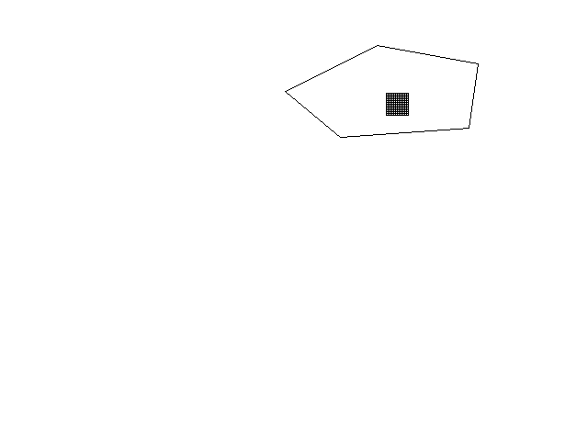
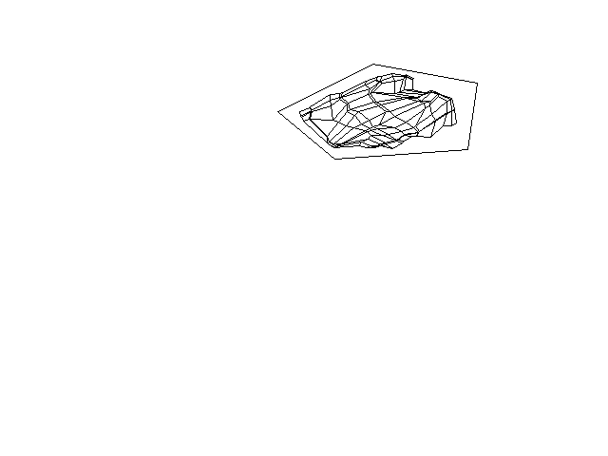
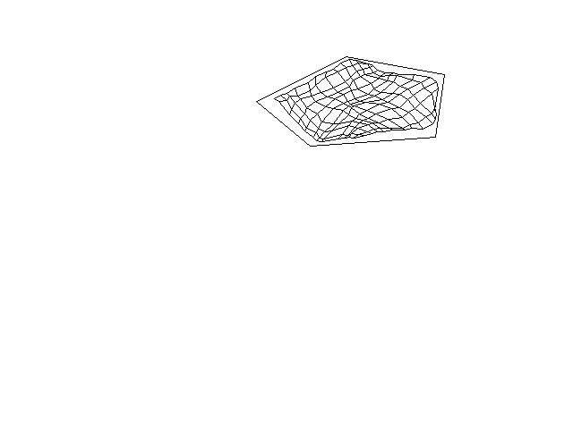
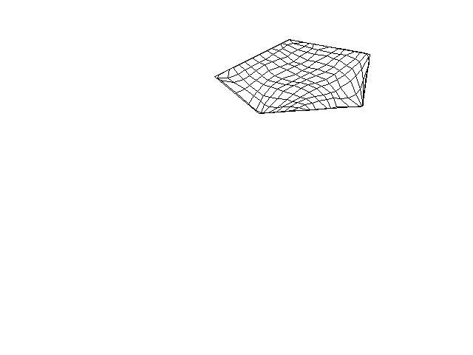
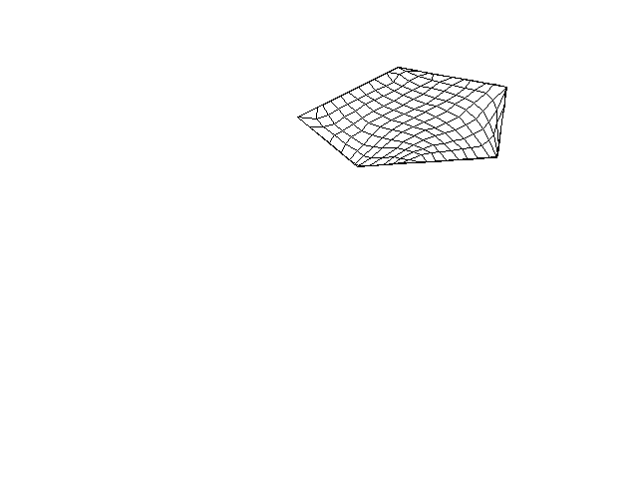
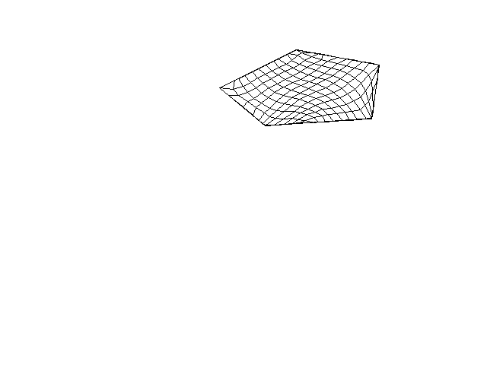
Placement of Mesh via Self Organizing NNs2
Iteration 0
Iteration 500;
Quality =288
Iteration 2000;
Quality = 238
Iteration 6000;
Quality =223
Iteration 12000;
Quality = 208
Iteration 30000;
Quality =202

Slide 11
Networks with Loops (1) (More next time)
Issues: Synchronous and Asynchronous Update?
Converges or continues forever?
Inhibitory or Exhibitory weights (i.e. positive or negative)

Slide 12


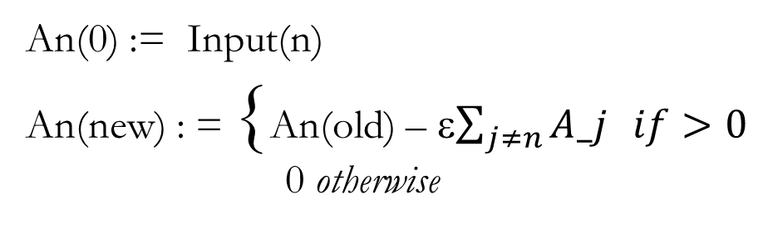
(MaxNet)
1
1
−ε
−ε
An(0) := Input(n)
An(new) : = {An(old) – ε$\sum_{j≠n}{A_j} if>0$
0 otherwise
−ε
−ε
−ε
−ε
−ε
−ε
−ε
−ε
−ε
1
1
−ε

Slide 13
(MaxNet): Competitive Network
1
1
−ε
−ε
An(0) := Input(n)
An(new) : = {An(old) – ε$\sum_{j≠n}{A_j} if>0$
0 otherwise
−ε
−ε
−ε
−ε
−ε
−ε
−ε
−ε
−ε
1
1
−ε

Slide 14
Reminder Independance and Correlations
Vectors a = (a1, a2, … an) and b = (b1,b2, … bn)
a and b are independent if a b = 0 (i.e. inner product; Σ(a_i b_i ) = 0 )
If we choose a from a set and b from a set the two sets are uncorrelated if the expectation of Σ(a_i b_i ) = 0. (That is, the average of such choices = 0.)
If normalized the inner product is between -1 and 1; like cosine so a metric between vectors.

Slide 15
Hamming Net and Correlations
Hamming Distance between binary (or bipolar) vectors is the number of indexes in which they differ.

Slide 16
Visualizing Weights and Vectors in Same Space

